Slide 1
Basic Coding Course
Week 6 – DOM Manipulation

Slide 2
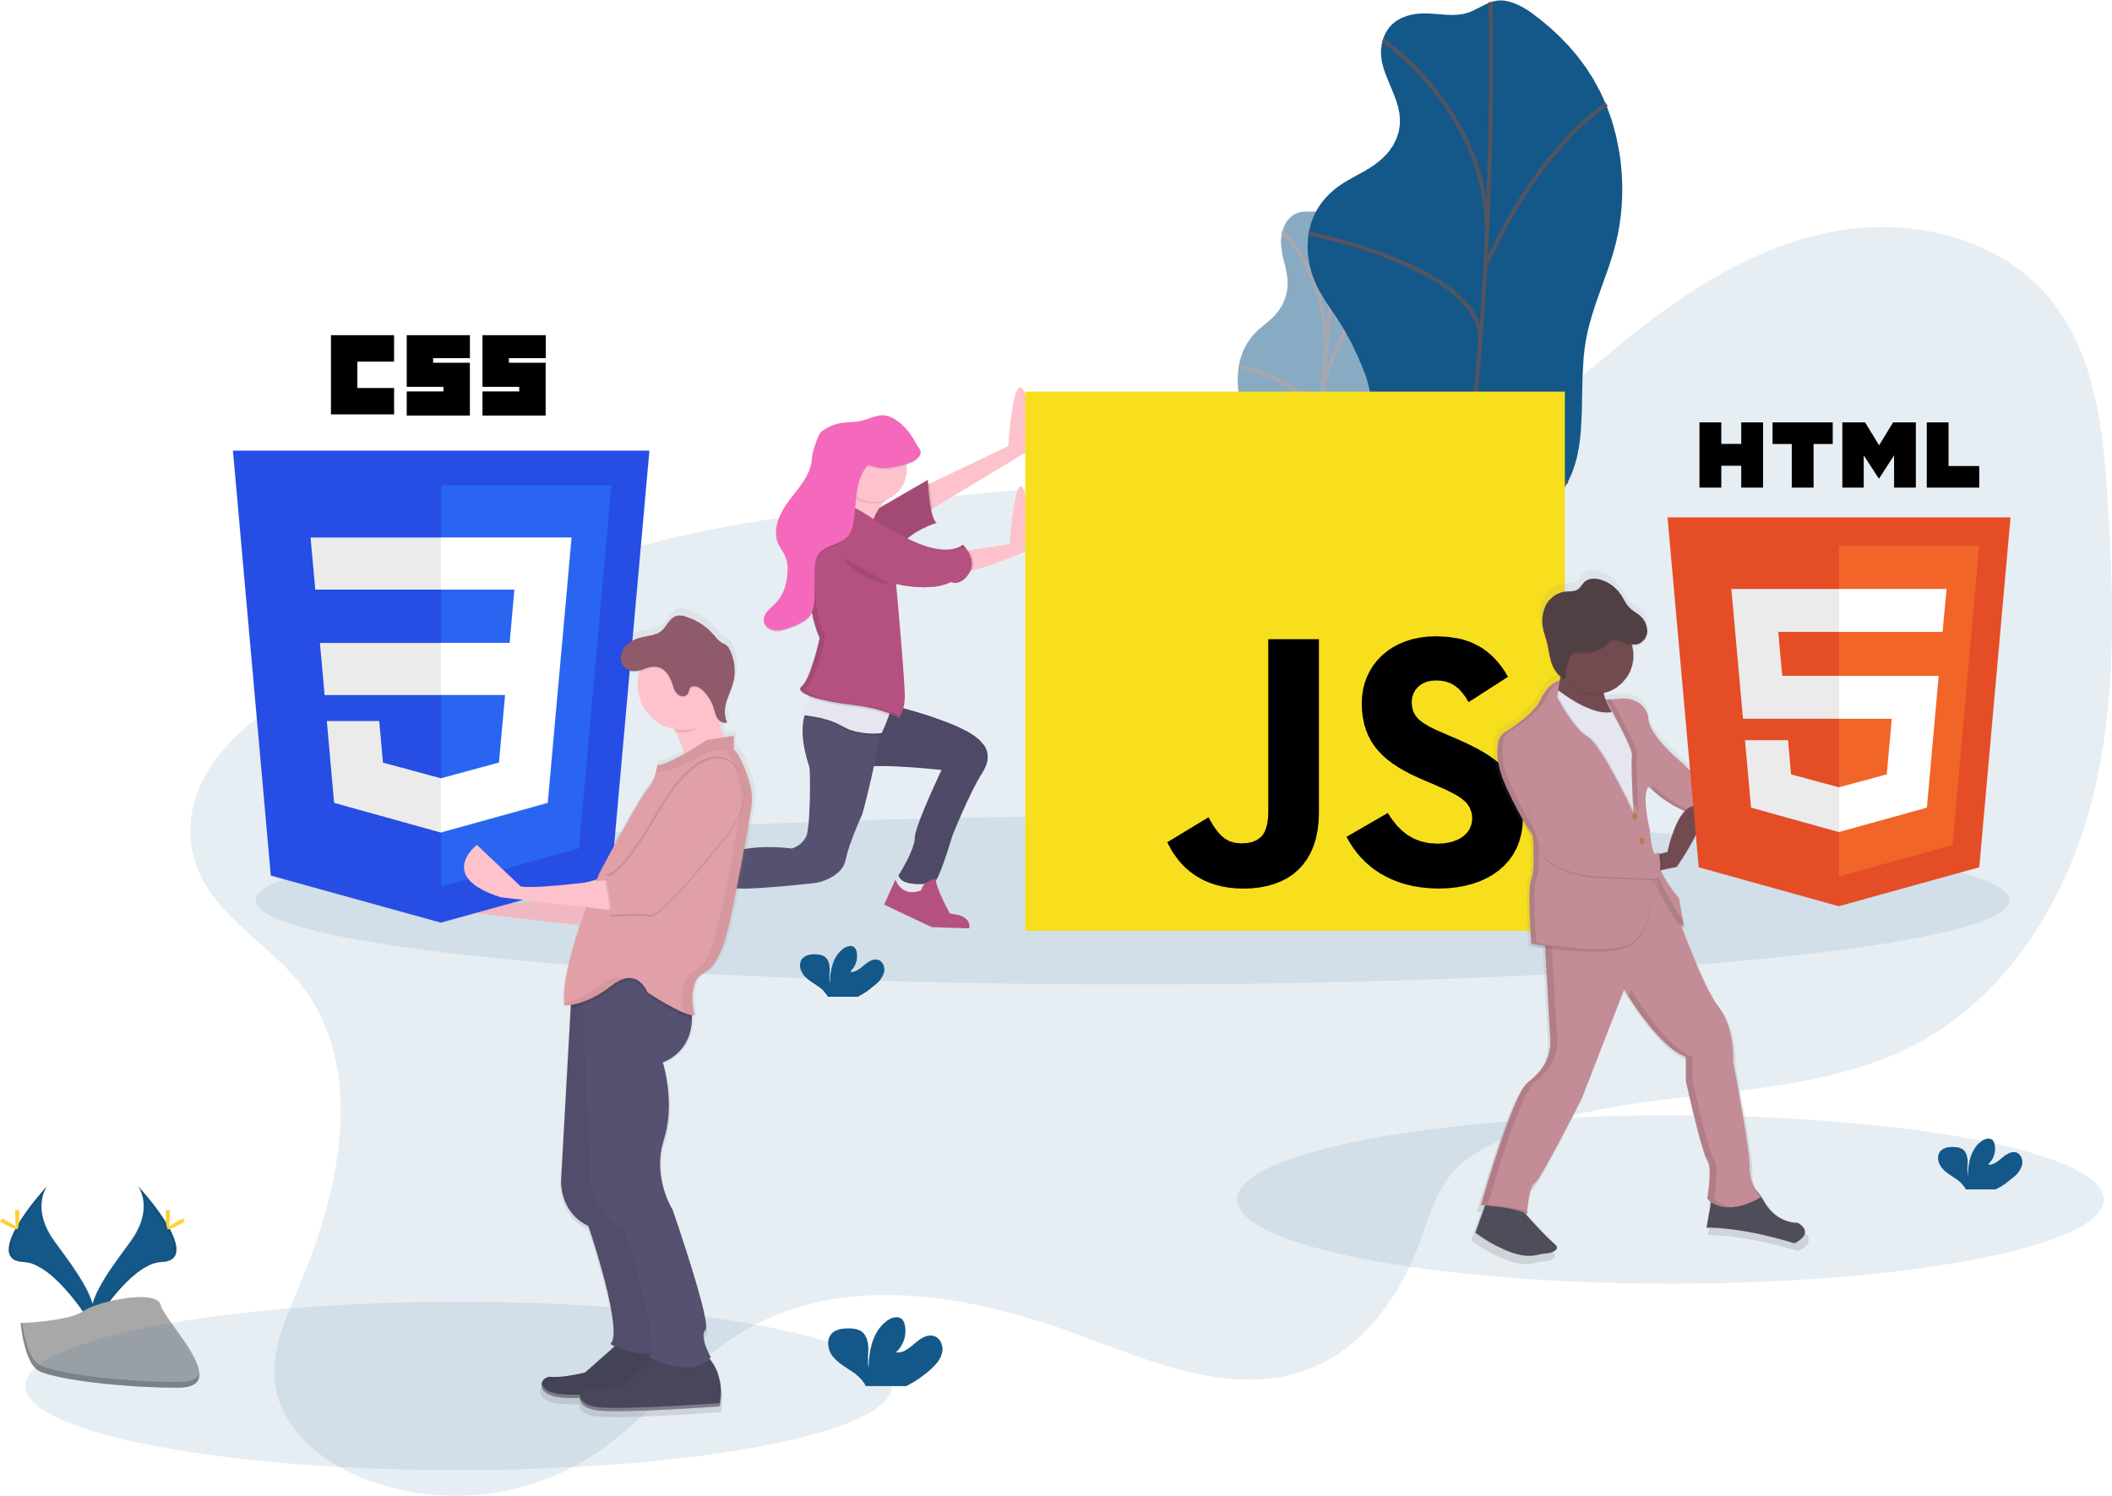
Document Object Model
Section 1

Slide 3
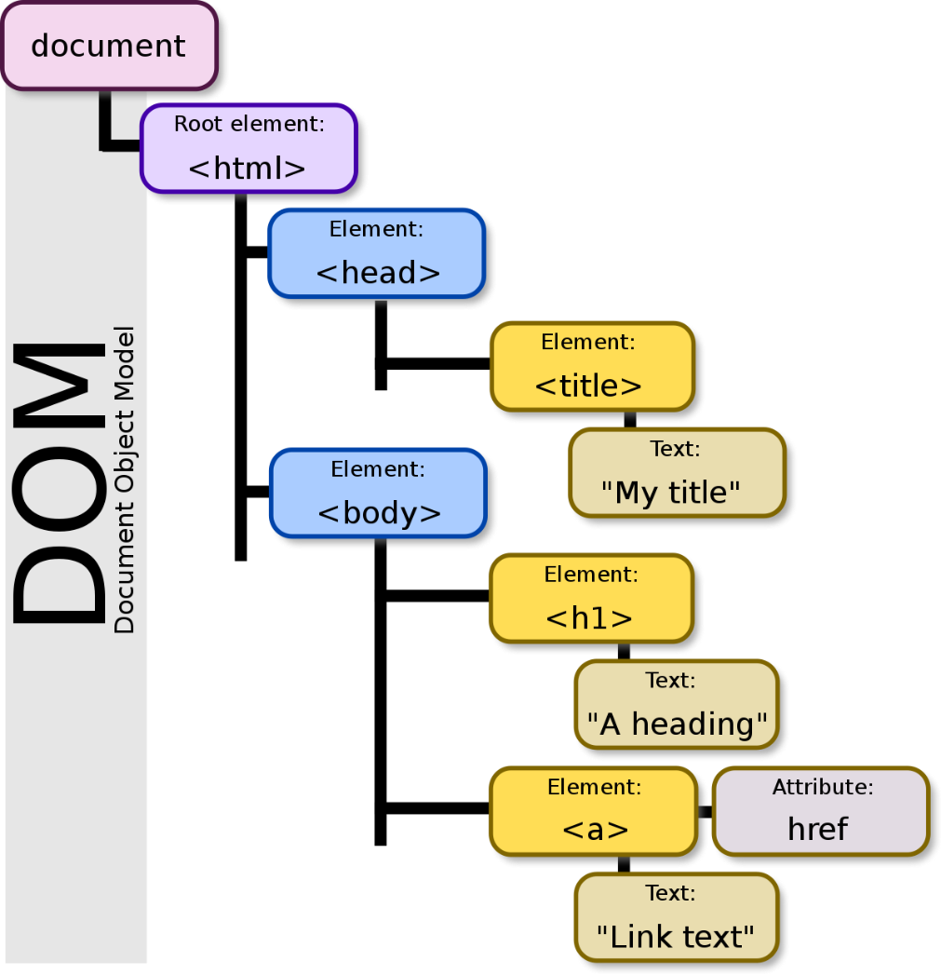
What is Document Object Model (DOM)? (1)
The Document Object Model, DOM, is a programming interface for web documents. It represents the structure of a web page and allows programs (usually written in JavaScript) to interact with and manipulate the content, structure, and style of web pages dynamically.
In simpler terms, it's a way for developers to access and modify the elements of a web page, such as HTML elements and their attributes, through code.

Slide 4
Reference Material
https://www.freecodecamp.org/news/how-to-manipulate-the-dom-beginners-guide/
https://www.w3schools.com/js/js_htmldom.asp

Slide 5
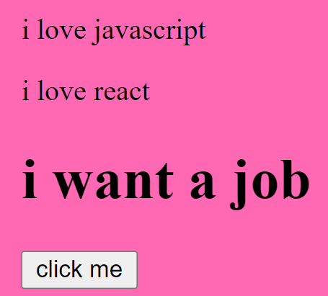
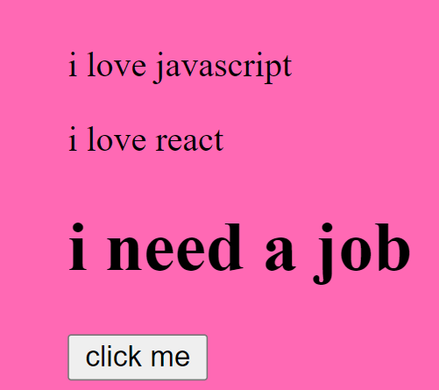
Why DOM is Important?
The DOM is essential because it enables developers to create interactive and dynamic web applications. By using JavaScript and the DOM, you can respond to user actions, update page content without reloading, validate form input, create animations, and much more. It's a core technology for building modern web applications
Button click

Slide 6
Key Concept
Tree Structure: The DOM represents a web page as a hierarchical tree structure. Each HTML element, including the root <html> element, is a node in the tree. These nodes are organized in a parent-child relationship, creating a structure similar to a family tree.
Nodes: Nodes in the DOM tree can be of several types, including elements, attributes, text, comments, and more. Elements represent HTML tags like <div>, <p>, and <a>. Attributes represent characteristics of elements.
Accessing Elements: JavaScript provides methods and properties to access elements in the DOM. You can select elements by their tag name, class name, ID, or other attributes. For example, document.getElementById("myElement") selects an element with the ID "myElement."
Manipulating Elements: Once you've selected an element, you can manipulate it by changing its content, attributes, or style. For example, you can use element.textContent to change the text inside an element or element.style.color to change its text color.
Events: The DOM allows you to attach event listeners to elements. Event listeners can trigger JavaScript functions when specific events occur, such as clicking a button or submitting a form.
Updating the DOM: When you make changes to the DOM, such as adding, removing, or modifying elements, the web page's appearance and behavior can change dynamically without requiring a full page reload. This is a fundamental aspect of building interactive web applications

Slide 7
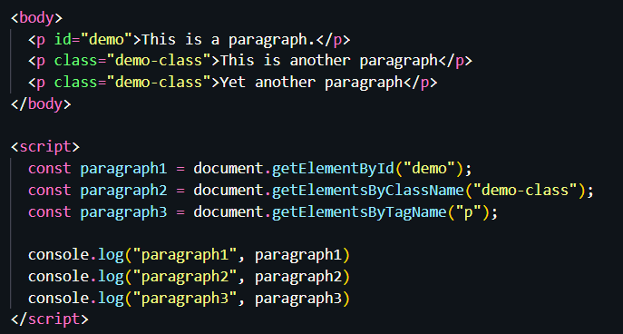
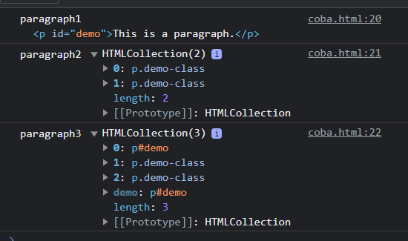
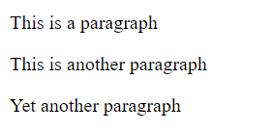
Accessing Elements
getElementById: This method allows you to select an element by its unique ID attribute. It returns the first element with the specified ID.
getElementsByClassName: This method retrieves all elements that have a specific class name and returns them as a collection (array-like object).
getElementsByTagName: You can select elements by their HTML tag name. This method returns a collection of all elements with the specified tag name.

Slide 8
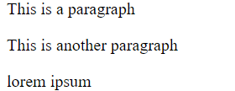

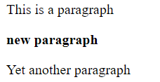

Modifying Contents
Manipulating elements in the Document Object Model (DOM) involves making changes to the content, attributes, or styles of HTML elements using JavaScript
textContent: You can change the text content of an element using the textContent property.
innerHTML: If you need to insert HTML content, you can use the innerHTML property.

Slide 9
Event Handler
Section 2

Slide 10
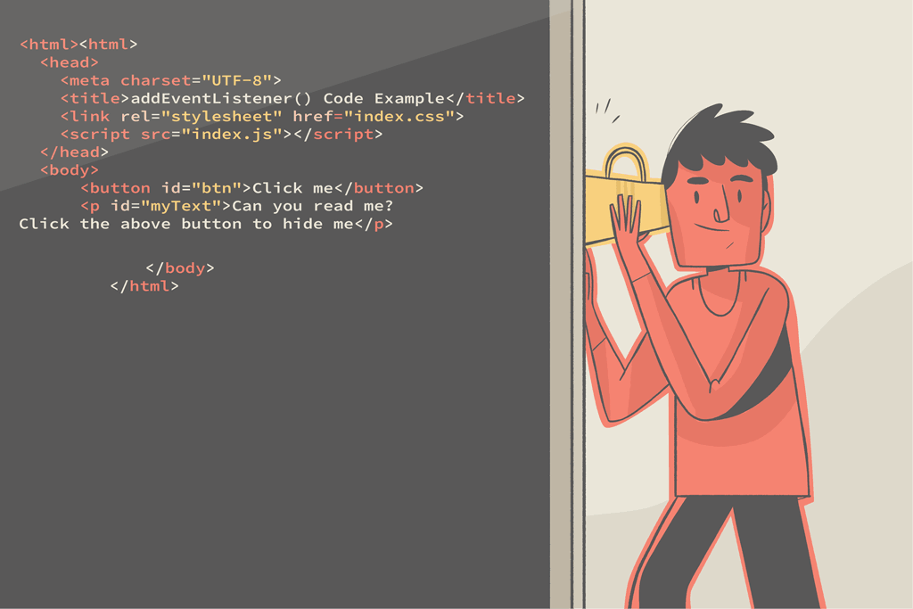
Event Listener
An event listener is a JavaScript function that waits for and "listens" to a specific event to occur on a DOM element, such as a button click, mouse movement, or keyboard input.
When the specified event occurs, the listener executes a predefined function or code block, responding to the event with the desired behavior.

Slide 11
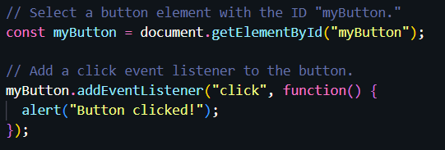
Adding Event Listener
Select the DOM element you want to listen to. You can use methods like getElementById, querySelector, or directly reference the element through its variable.
Use the addEventListener method to attach an event listener to the selected element. The method takes two main arguments:
The type of event you want to listen for (e.g., "click," "mouseover," "keydown").
A callback function that defines what should happen when the event occurs.

Slide 12
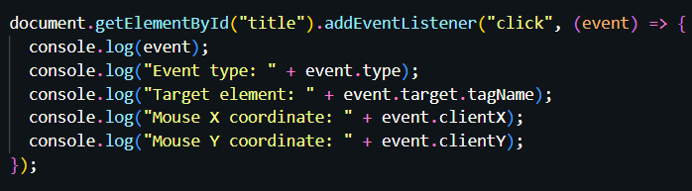
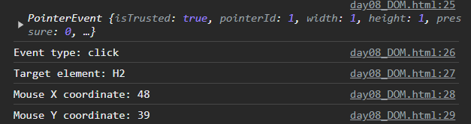
Event Object
When an event occurs, an event object is automatically created and passed to the event listener as an argument. This object contains information about the event, such as the target element, event type, mouse coordinates, and more. You can access this object inside the event listener's callback function.
event object
For more explanation and examples on event object props you can see here:
https://www.w3schools.com/jsref/dom_obj_event_prop.asp

Slide 13
Common Event Object Properties
Properties | Note
event.type | Contains a string representing the type of event that occurred (e.g., "click," "keydown," "mousemove").
event.target | Refers to the element that triggered the event. It is often used to access the element that the event is associated with.
event.preventDefault() | Prevent the default behavior of an event. For example, you can use it to prevent a form from submitting or to prevent a link from navigating to a new page.
event.clientX & event.client | These properties provide the X and Y coordinates of the mouse pointer when a mouse-related event occurs. They are often used in mouse event handling.
event.keycode | In keyboard events, this property contains the numeric code of the key that was pressed. It's useful for detecting specific keyboard keys.
event.target.value | For form input events, this property holds the current value of the input element that triggered the event. It's commonly used to access user input.

Slide 14
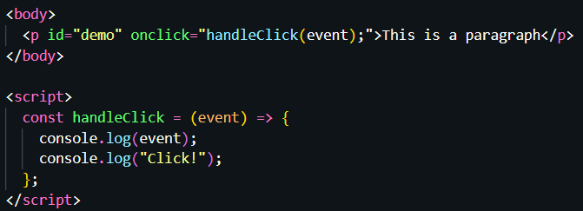
Inline Events Handlers
Events in HTML elements, such as the “onclick” attribute, allow you to define event handlers directly within the HTML. These inline event handlers execute JavaScript code when the specified event occurs on the element.
Event Attribute: To add an inline event handler to an HTML element, you use an event attribute like onclick, onmouseover, onkeydown, etc. These attributes are added directly to the HTML element within its opening tag.
JavaScript Code: The value of the event attribute is JavaScript code enclosed in quotation marks. This code is executed when the associated event occurs on the element.
Event Attribute
JS Code
Event Object

Slide 15
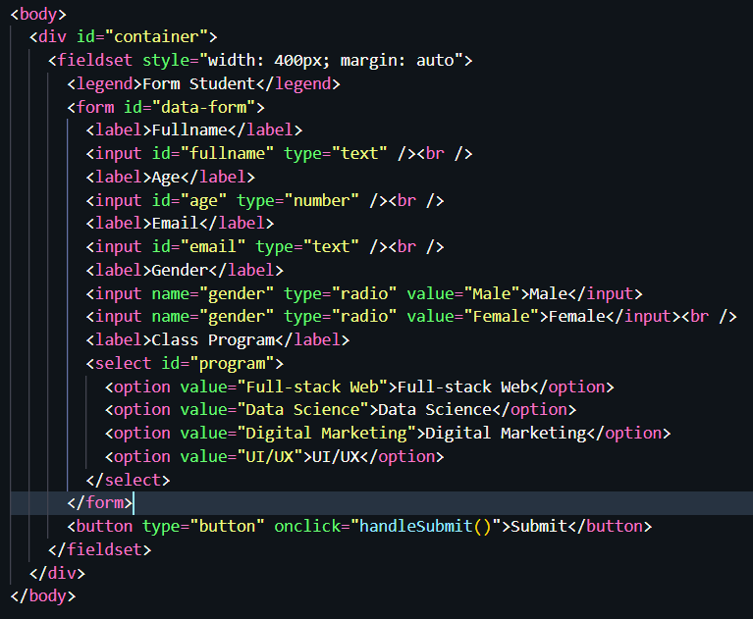
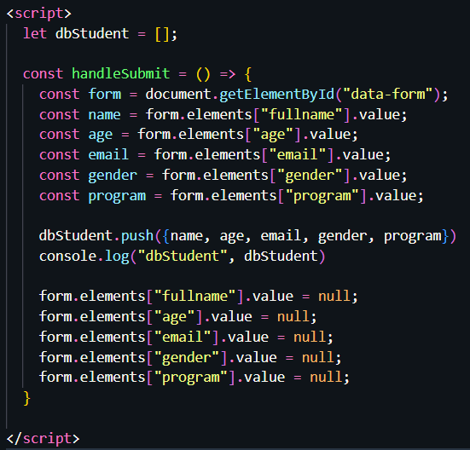
Accessing Form Value Example
“resetting” form after submit

Slide 16
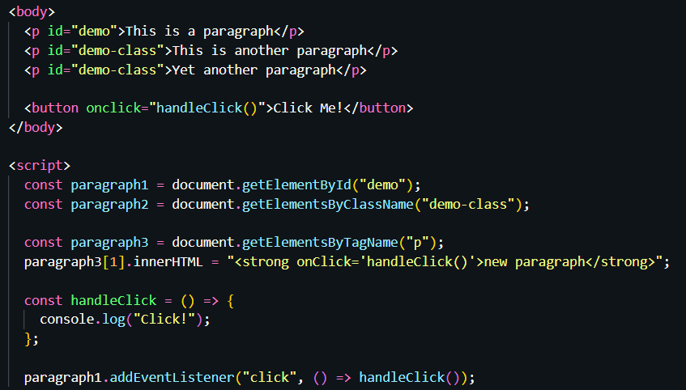
Example (1)
You can directly add the event handler in innerHTML part to run a function

Slide 17
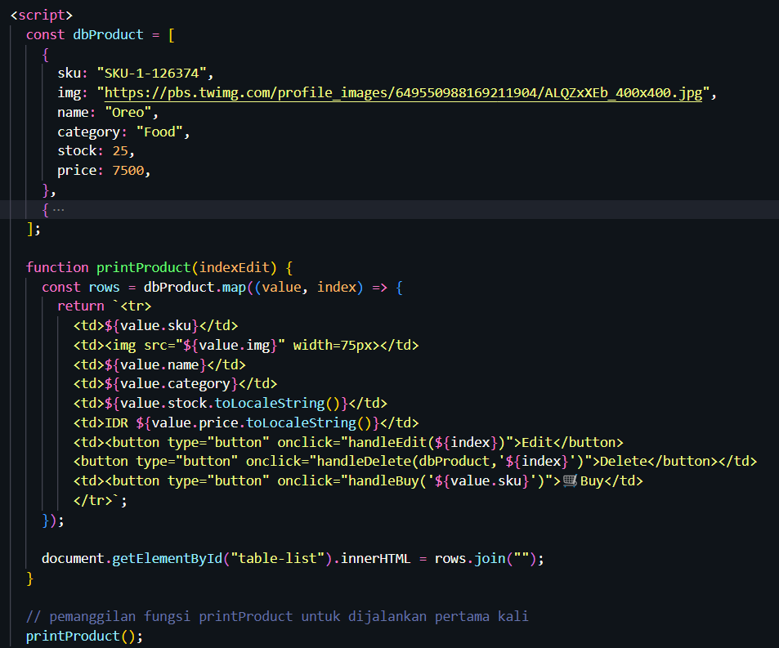
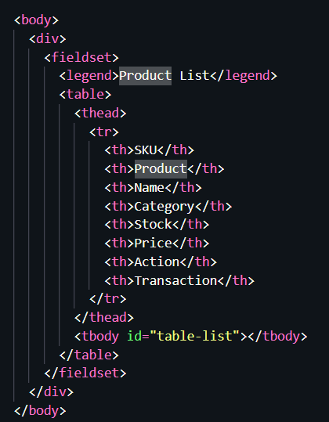
Example (2)

Slide 18
Additional - classList
In JavaScript, the classList property is an attribute of DOM elements, particularly those representing HTML elements with CSS classes.
It provides a convenient way to manipulate the classes of an element, such as adding, removing, or toggling classes.
element.classList.add(className1, className2, ...)
This method adds one or more class names to the element. You can pass multiple class names as arguments, and they will be added to the element's existing classes.
element.classList.remove(className1, className2, ...)
This method removes one or more class names from the element. Similar to add(), you can pass multiple class names to remove.
element.classList.toggle(className, force)
This method toggles the presence of a class name on the element. If the class is not present, it adds it; if it's already present, it removes it. You can also use the optional force parameter to explicitly specify whether to add (true) or remove (false) the class.

Slide 19
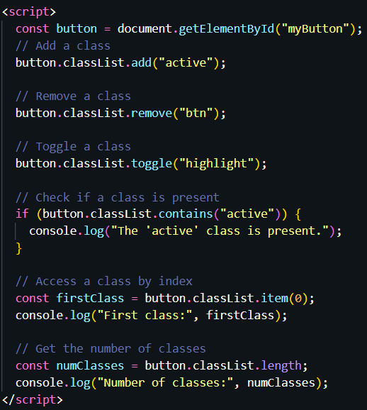

classList Usage Example

